Slide 1
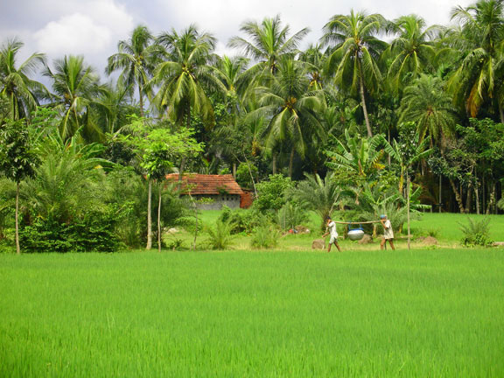
Welcome to you all in my English class.
Good Morning

Slide 2
Teachers Identity
Md. Abdul Jalil MA (B Ed 1st )
Assistant Headmaster
Mohishbathan Adarsha Girl’s High School
Rajpara –Rajshahi
Resource Teacher (English) (SEQAEP)
Master Trainer (English) (TQI & BRAC)
E-mail: jalilrajshahi@gmail.com
Skype: abdul.jalil433
Blog: englishforsecondaryinfo.blogspot.com

Slide 3
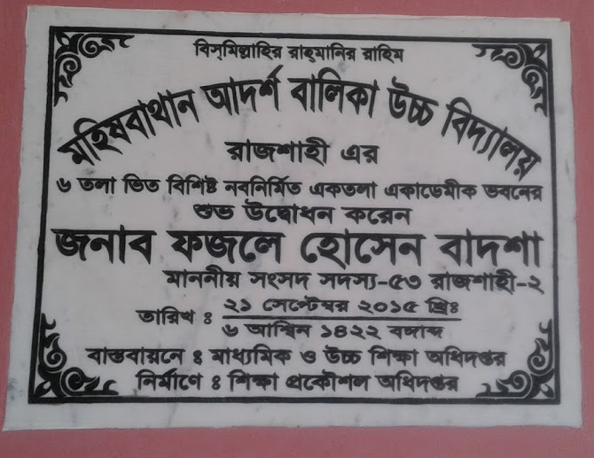
Time : 45 minutes

Slide 4
Let us observe some images.
Notes:
No need to click.

Slide 5
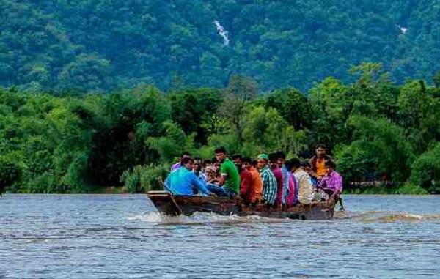
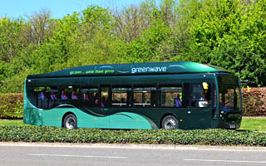
1. What do you see in the picture?
2. Did you visit any historical place?
3. How did you go there?

Slide 6
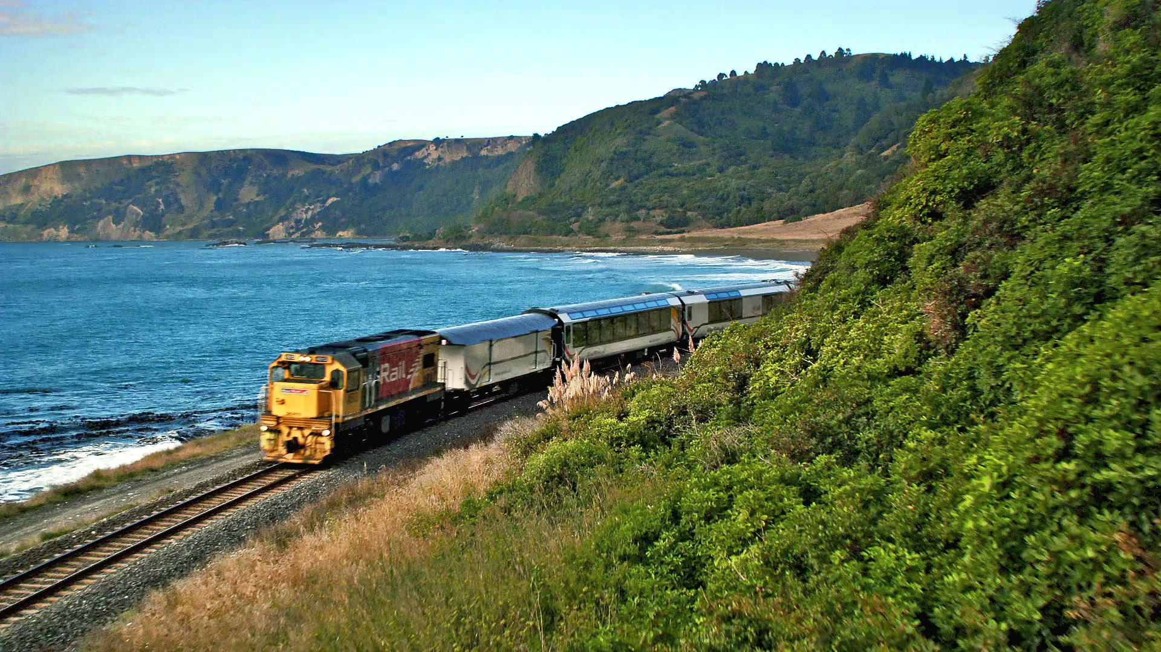
Journey by Train

Slide 7
Composition
A Journey By train.

Slide 8
Objects
By the end of the lesson ss will be able to
Tell the necessary things for a journey.
Describe the way of our country.
Describe a historical place.

Slide 9
Preparation for the journey.

Slide 10
What did you do before the journey?
(Write five sentences individually)

Slide 11
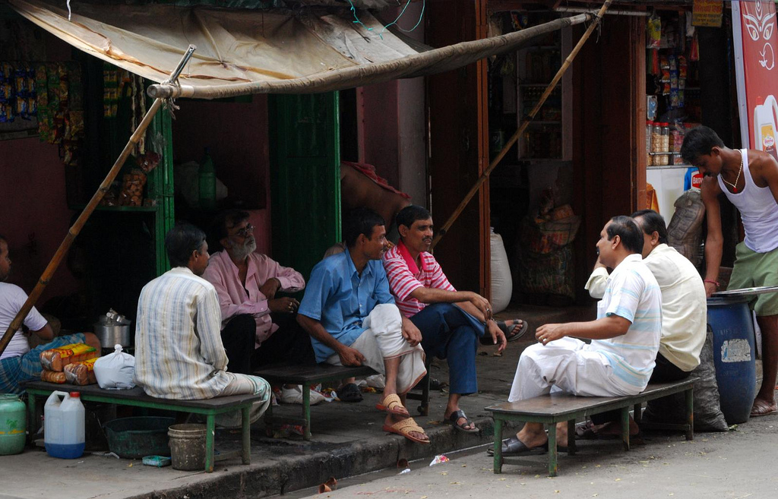
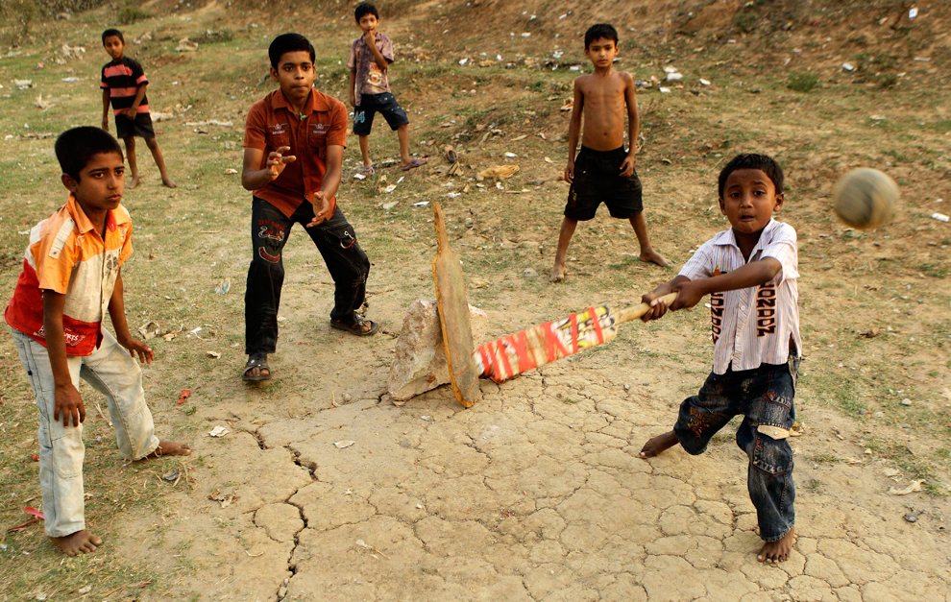
Some people are gossiping at the tea stall.
Some boys are playing in the field.

Slide 12
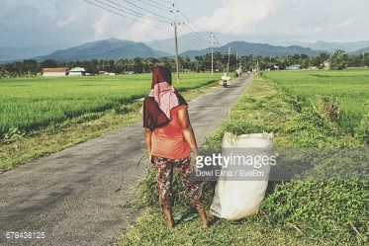
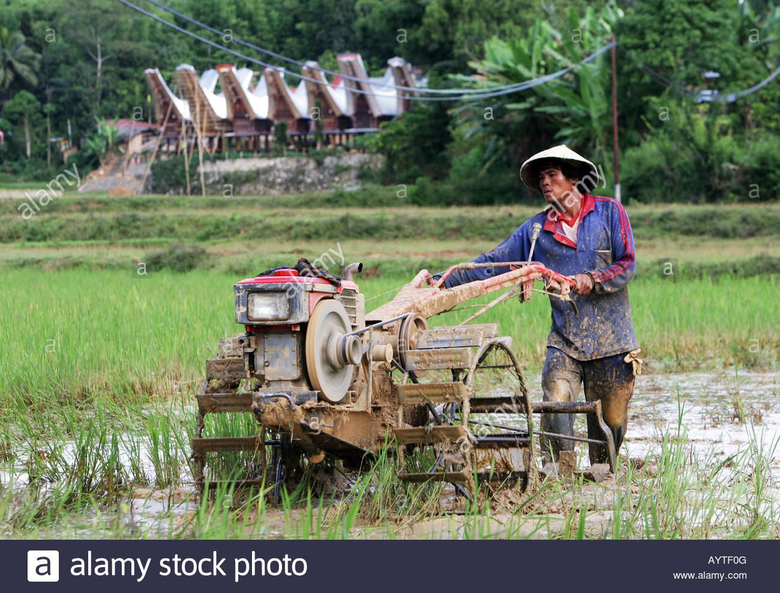
We saw the playing of green paddy with wind.
Farmer are working in the field.

Slide 13
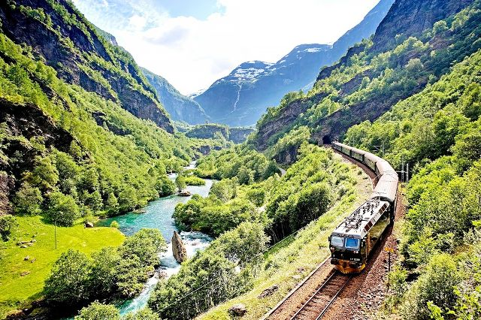
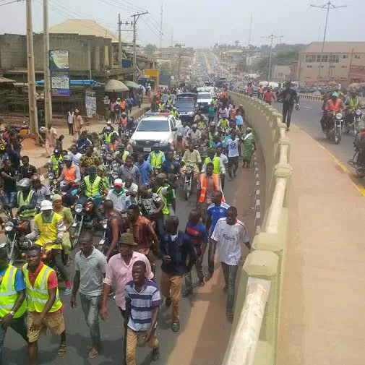
We saw lake, garden, hill, catching fish, bathe in the river.
We saw meeting on the road, market and many industry on the way of Bager hat.

Slide 14
What did you see on the way of Bager hat?
(work in pair)

Slide 15
3
5
7
9
1
11
2
4
6
10
8

Slide 16
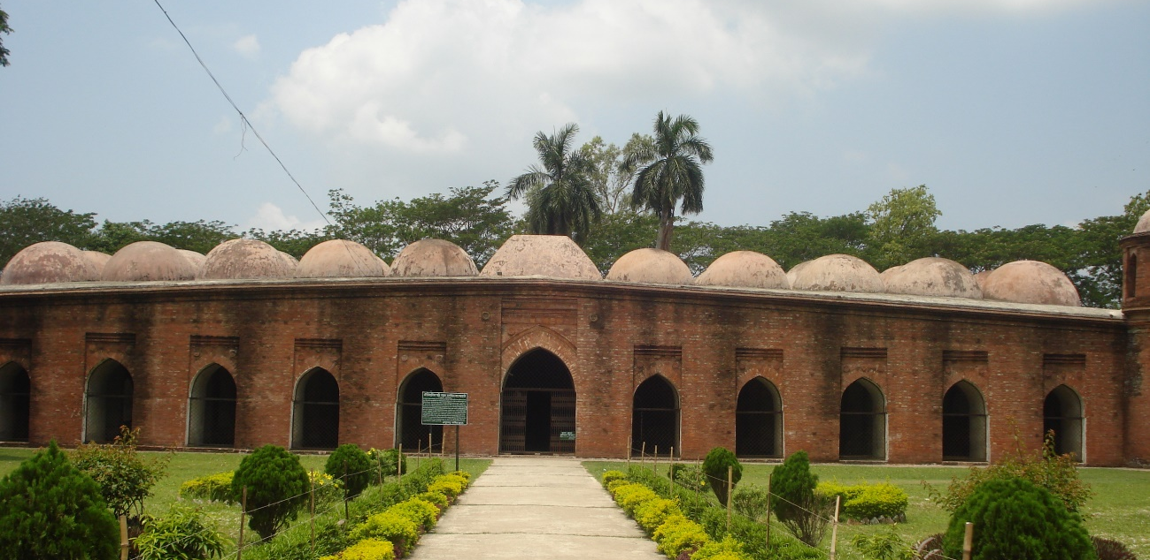
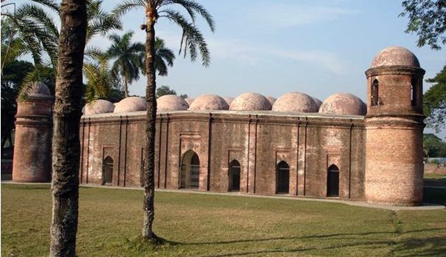
11
7
11x7=77 domes.
There are 77 low domes arranged in seven rows of eleven, and one dome on each corner, bringing the total to 81 domes.

Slide 17
3
5
7
9
1
11
2
4
6
8
10

Slide 18
It is used artist pattern and terracotta.
The mosque was used for prayers, and also as a madrasah and assembly hall.

Slide 19
Describe the shat gumbos mosque. (In group)

Slide 20
Evaluation
01 . How many chowchilla in the shat Gombuj Mosque?
a. 07
b. 09
Try again
Try again
Try again
Thanks
c. 11
d. 13
02. What is the benefit of a journey?
b. Build body
a. Cost money
Try again
Try again
Thanks
Try again
d. Refresh mind
c. Go with friend

Slide 21
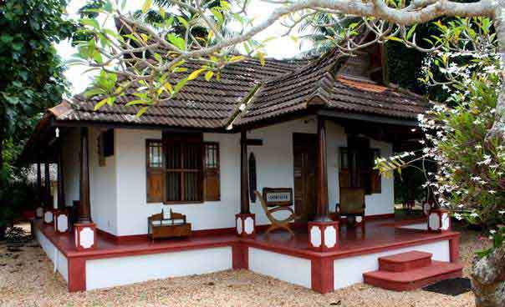
Home
Work
Write a composition on A Train Journey.

